Slide 1
Content-based Seismic Image Retrieval
Mohammad Tanvir Rahman
Mentor: Fangkai Yang, Floyd Broussard
Applied Technology and Innovation Team

Slide 2
About me
Born in Bangladesh
BS in CSE from BUET, Bangladesh
PhD Student, CS, University of Houston
Research interest: Volunteer/Cloud computation
Teaching Assistant, University of Houston (2012-present)
Experience:
Software Engineer Intern, Schlumberger Information Solutions 2015
Finalist, Ocean Academic competition 2015
Software Intern, Advantek Internation, Houston, Texas
Deputy Manager, IT, Abul Khair Group, Bangladesh
Specialist, Robi Axiata Limited, Bangladesh
Software Engineer, Vonair software services, Bangladesh
Interest:
Love Travelling, Drawing Sketches, Photography

Slide 3
Problem Description
Bob has to interpret a new seismic image to identify a sweet spot
Bob searches through the huge image repository manually
Finds a set of Seismic images that he thinks looks similar to his reference image
Checks the metadata of each of these images to find images whose contents match with the reference image
Bob now studies the set of images that are really similar to the reference image.
Bob makes a decision.
Notes:
Bob realizes that this image looks similar to a previous image he worked on last month.

Slide 4


Motivation
Geophysicists have to spend huge amount of time in looking for similar historical cases from repository in order to interpret a new seismic image.
It will save them huge amount of time and increase productivity if a software can
analyze stored repository images
suggest similar seismic images to geophysicists and
accelerate the interpretation of new seismic images

Slide 5
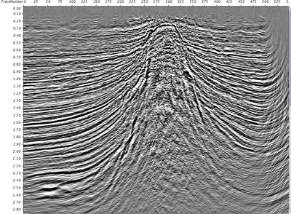
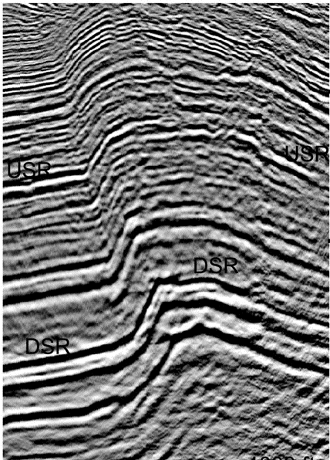
Content-based Similarity Identification
Consider both visual and textual information of repository images for similarity identification and retrieval
Visual features vary because of resolution and noise, and textual information complements visual features.
Allow user to provide feedback and refine search results
Salt dome
Fold
Notes:
From 4, That is why user feedback is very much important in content based similarity identification. In oil & gas industry, decisions are very crucial. It is better if software only helps to provide/ accelerate a decision rather than giving the final decision. The final decision should come from human expert. Just like, if a person is sick, he would prefer to take advice from a human doctor rather than from a software which can analyze disease syndromes. That is why, in our plugin we allow user to provide feedback and refine the search result based on the feedback

Slide 6
Content-based Similarity Identification
3 steps:
Use computer vision algorithm called spatial envelope to extract GIST feature and identify visually similar image
Receive user feedback on suggested images
Refine results based on textual distance

Slide 7
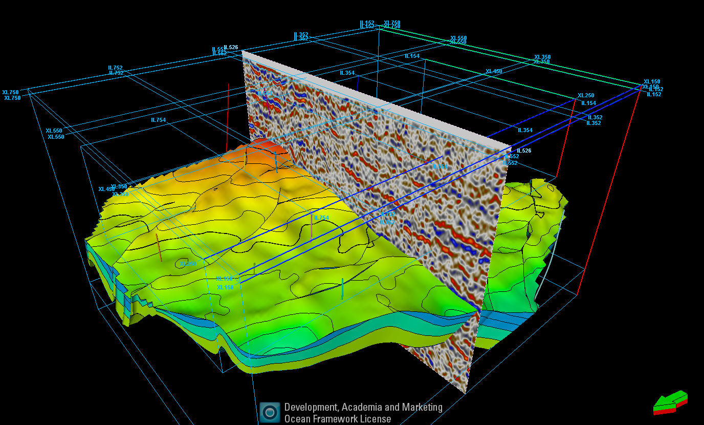
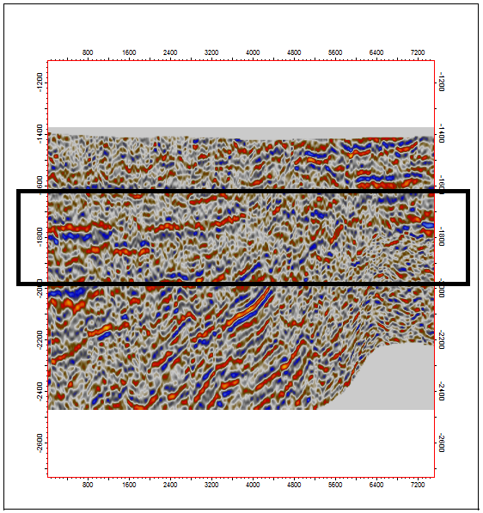
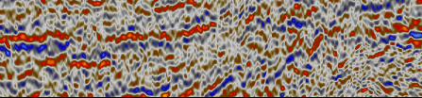
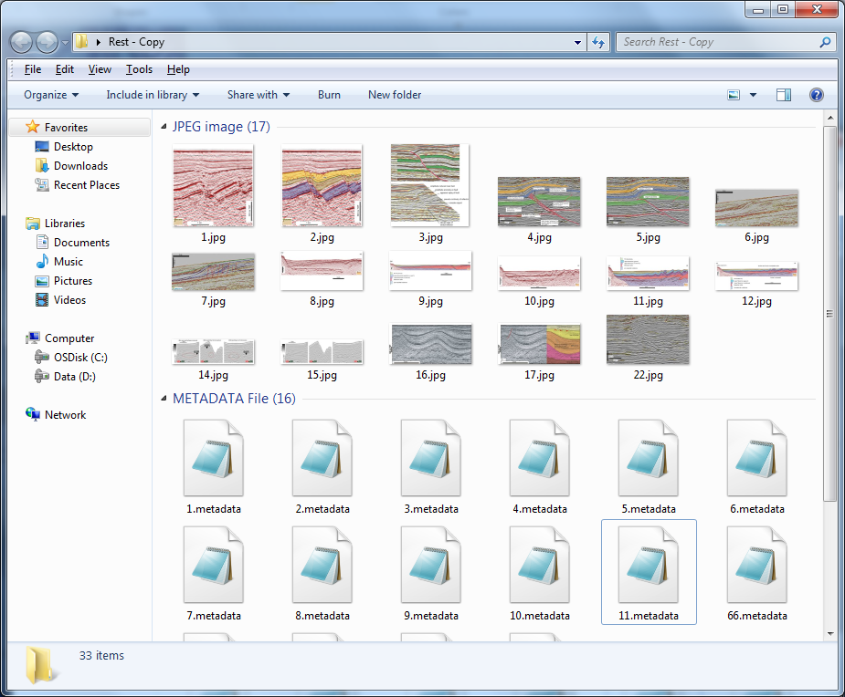
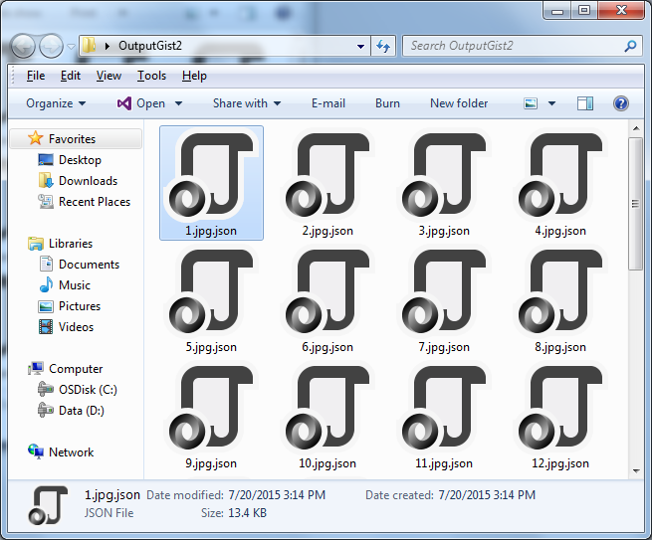
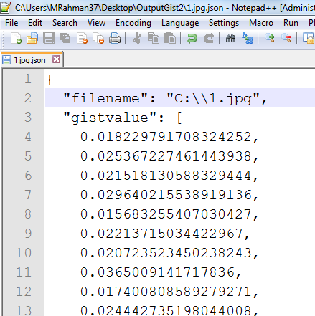
Plugin Workflow
3D Seismic Object
2D Seismic Object
Extract
2D view
along intersection
Snip tool Window
Reference Image
Feature extraction
Image repository (Image + Metadata)
Saved gist features
Feature extraction
Calculate
feature distance
Source: http://seismicatlas.org/

Slide 8
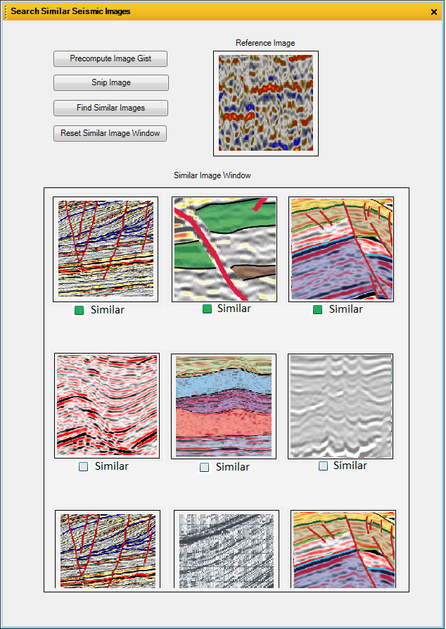
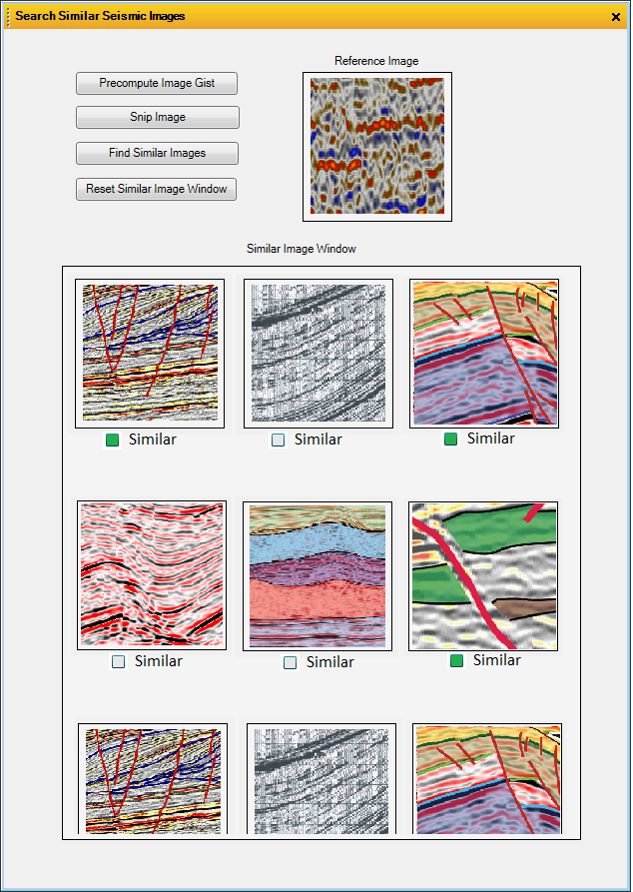
Plugin Workflow
3D Seismic Object
Extract
2D view
along intersection
2D Seismic Object
Snip tool Window
Reference Image
Feature extraction
Image repository (Image + Metadata)
Saved gist features
Feature extraction
Calculate
feature distance
Tooltip showing
Metadata
Similar Images loaded
in UI based on user selection
Continental Margins: Passive
Gravity: DW fold-thrust belts
Physical Geography: Oceans
Similar Images loaded in UI
Search refinement
Based on user feedback

Slide 9
Features
Implemented both as Petrel plugin & standalone WPF application, for future extension to other software platform
Implemented as a snip-retrieval tool such that user can capture any image fragment as input
User can adjust weights between visual and textual information that affects retrieval results
Native implementation of most library functions; does not rely on external library
User friendly and simple UI
Features of repository images are stored as JSON file, for easy data exchange and sharing

Slide 10
Algorithms
Spatial Envelope: To extract GIST features of repository images for visual similarities (Oliva&Terralba,2001)
K-Nearest Neighbors (KNN): To identify similar images based on textual distance
Distance, D = α d(G_{i}, G_{j}) + (1- α) L(M_{i} , M_{j} )
Where, α = User defined Priority parameter
d(G_{i}, G_{j}) = Difference between Gist feature vector of Image_{i} & Image_{j}
L(M_{i} , M_{j} ) = Levenshtein (Edit) distance between Metadata of Image_{i} & Image_{j}

Slide 11
Performance
Feature extraction for repository image is computed offline, so the majority of computation does not affect run time performance
Gist distance and textual distance computation is in polynomial time
Native implementation of image retrieval function aims to provide flexibility for future optimization
Due to limited time, we could not consult with a geophysicist to evaluate the result

Slide 12
Challenges
Background knowledge about seismic interpretation and geology.
Solving complex math problem from Computer Vision and Machine Learning
Working with WPF(Windows Presentation Foundation) applications
Working with Petrel
Notes:
(2): have to do a lot of complex equation solution, Matrix manipulation, Fourier transformations to implement the algorithm from scratch. After each step, I had to do a lot of test to verify the functions I just implements provides the exact same result of the reference matlab code.

Slide 13
Future works
Evaluate and improve the algorithm with geophysicists
Considering metadata structure and indexing for textual similarity
Optimizing the gist features extraction
Design and implement “collaborative filtering” regarding similar seismic image recommendation (based on metadata)
Collaborative Filtering is a method of making automatic predictions (filtering) about the interests of a user by collecting preferences from other users.

Slide 14


Collaborative Filtering
 | Pictures | Books | Movies | Video games
A
B
C
D
E |  |  | ???

Slide 15
Collaborative Filtering
 | Pictures | Books | Movies | Video games
A
B
C
D
E |  |  | ???

Slide 16
Collaborative Filtering
 | Pictures | Books | Movies | Video games
A
B
C
D
E

Slide 17
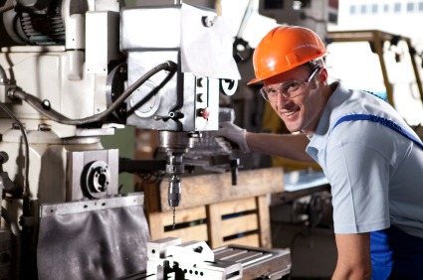


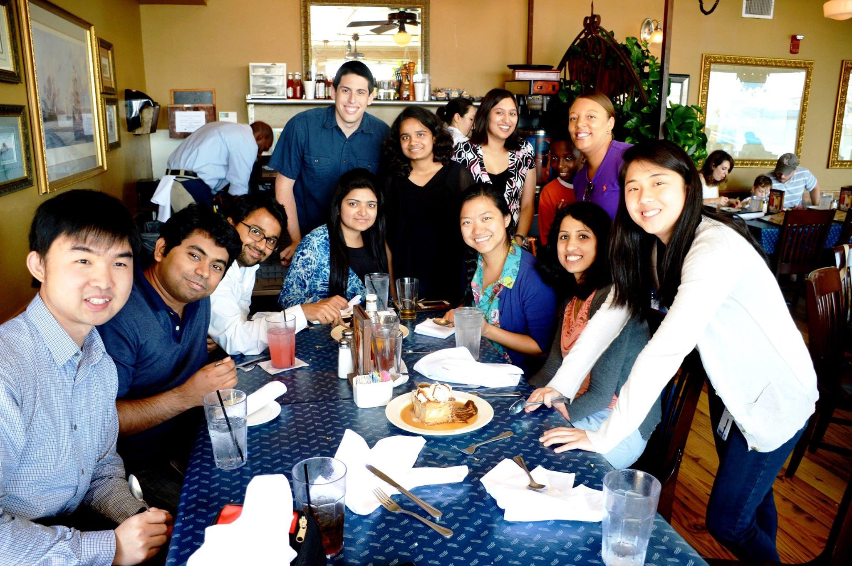
Take away from my internship
Got Experience
Networking
Money was good
Fun with new Friends
Notes:
Oil and gas industry and computer vision connection. First time I realize AI (Computer vision and machine learning) has a lot of prospects in oil and gas industry.

Slide 18
Acknowledgment
Special Thanks to
Fangkai Yang
Floyd Broussard
Peter Zaborski
Siham Jami
All interns

Slide 19
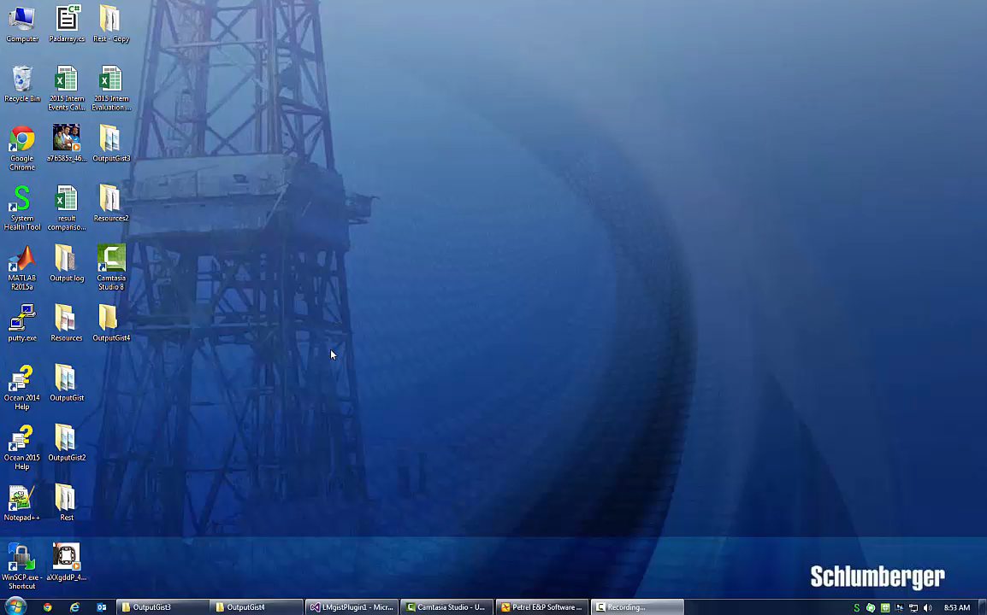
Demo

Slide 20
Questions

